Slide 1
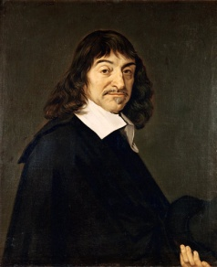
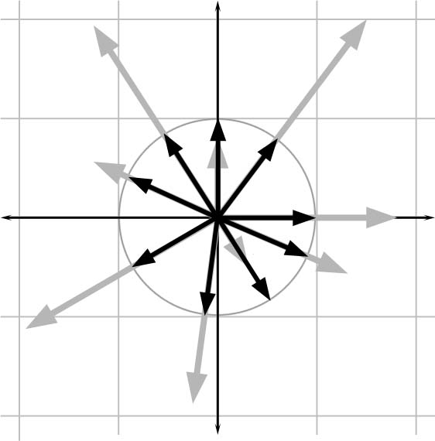
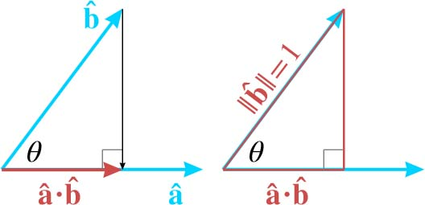
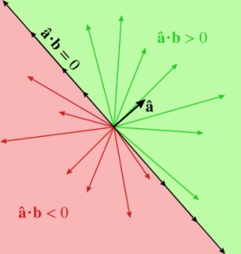
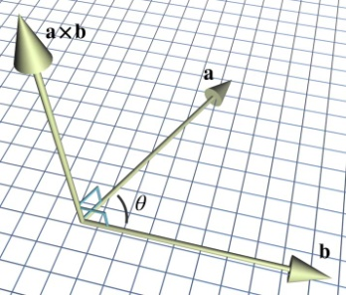
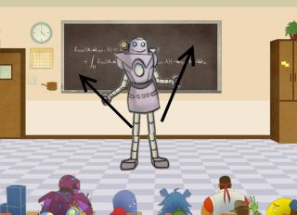
Vectors
Fletcher Dunn
Valve Software
Ian Parberry
University of North Texas
3D Math Primer for Graphics and Game Development

Slide 2
What You’ll See in This Chapter
This chapter is about vectors. It is divided into thirteen sections.
Section 2.1 covers some of the basic mathematical properties of vectors.
Section 2.2 gives a high-level introduction to the geometric properties of vectors.
Section 2.3 connects the mathematical definition with the geometric one, and discusses how vectors work within the framework of Cartesian coordinates.
Section 2.4 discusses the often confusing relationship between points and vectors and considers the rather philosophical question of why it is so hard to make absolute measurements.
Sections 2.5–2.12 discuss the fundamental calculations we can perform with vectors, considering both the algebra and geometric interpretation of each operation.
Section 2.13 presents a list of helpful vector algebra laws.

Slide 3
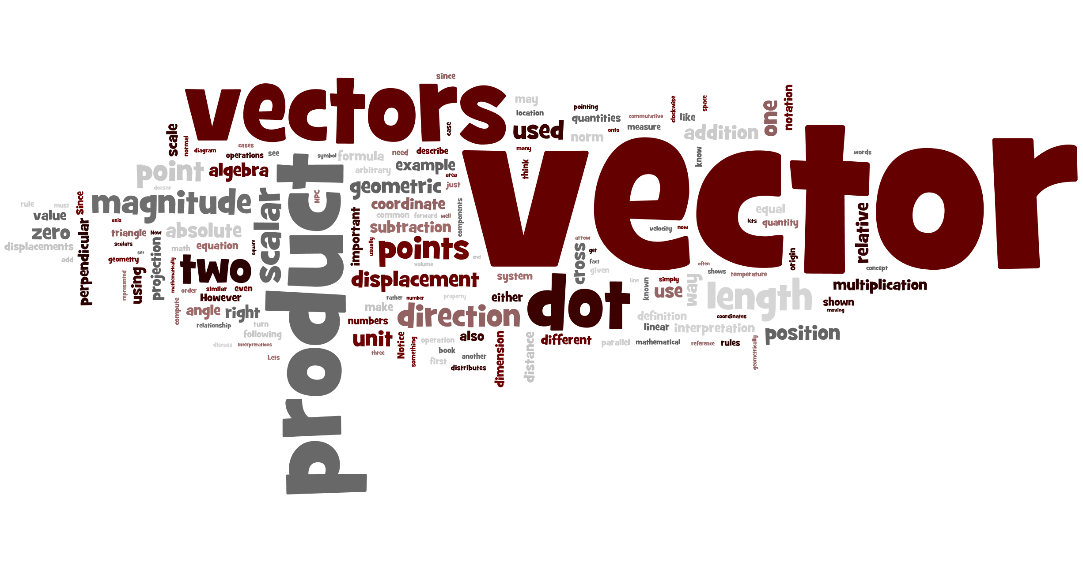
Word Cloud

Slide 4
Section 2.1: Mathematical Definition and Other Boring Stuff

Slide 5
Vectors and Scalars
An “ordinary number” is called a scalar.
Algebraic definition of a vector: a list of scalars in square brackets. Eg. [1, 2, 3].
Vector dimension is the number of numbers in the list (3 in that example).
Typically we use dimension 2 for 2D work, dimension 3 for 3D work.
We’ll find a use for dimension 4 also, later.

Slide 6

Row vs. Column Vectors
Vectors can be written in one of two different ways: horizontally or vertically.
Row vector: [1, 2, 3]
Column vector:

Slide 7
More on Row vs. Column
Mathematicians use row vectors because they’re easier to write and take up less space.
For now it doesn’t really matter which convention you use.
Much.
More on that later.

Slide 8
Our Notation
Bold case letters for vectors eg. v.
Scalar parts of a vector are called components.
Use subscripts for components. Eg. If
v = [6, 19, 42],
its components are v₁ = 6, v₂ = 19, v₃ = 42.

Slide 9
More Notation
Can also use x, y, z for subscripts.
2D vectors: [v_{x}, v_{y}].
3D vectors: [v_{x}, v_{y}, v_{z}].
4D vectors [v_{x}, v_{y}, v_{z}, v_{w}].
(We’ll get to w later.)

Slide 10
Even More Notation
Scalar variables will be represented by lowercase Roman or Greek letters in italics: a, b, x, y, z, θ, α, ω, γ.
Vector variables of any dimension will be represented by lowercase letters in boldface: a, b, u, v, q, r.
Matrix variables will be represented using uppercase letters in boldface: A, B, M, R.

Slide 11
Terminology
Displacement is a vector (eg. 10 miles West)
Distance is a scalar (eg. 10 miles away)
Velocity is a vector (eg. 55mph North)
Speed is a scalar (eg. 55mph)
Vectors are used to express relative things.
Scalars are used to express absolute things.

Slide 12
Section 2.2: Geometric Definition

Slide 13
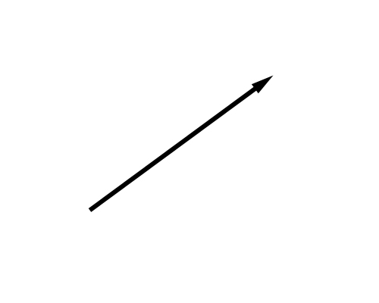
Geometric Definition of Vector
A vector consists of a magnitude and a direction.
Magnitude = size.
Direction = orientation.
Draw it as an arrow.

Slide 14
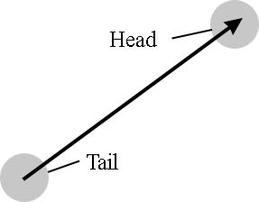
Which End is Which?

Slide 15
Terminology
Displacement is a vector (eg. 10 miles West)
Distance is a scalar (eg. 10 miles away)
Velocity is a vector (eg. 55mph North)
Speed is a scalar (eg. 55mph)
Vectors are used to express relative things.
Scalars are used to express absolute things.

Slide 16
Section 2.3: Specifying Vectors Using Cartesian Coordinates

Slide 17
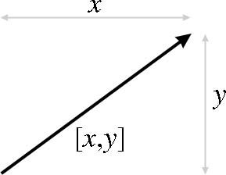

Slide 18
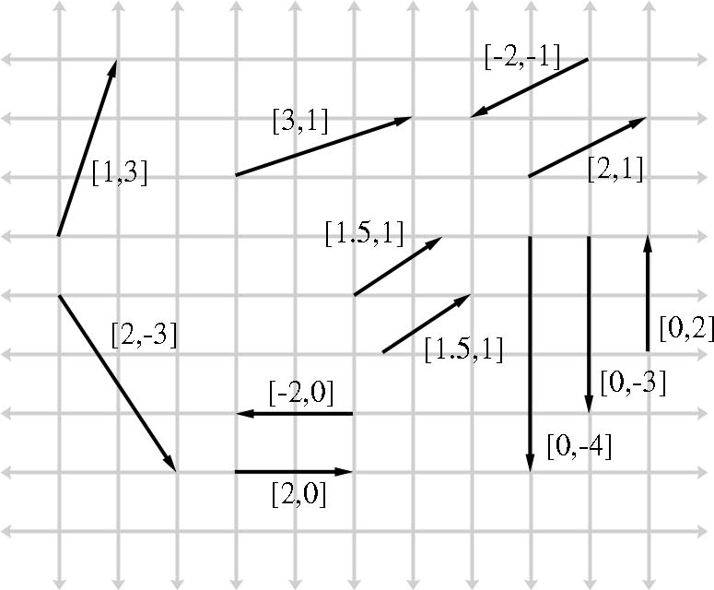

Slide 19
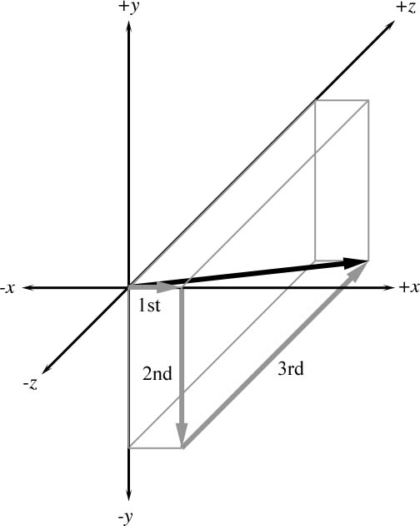

Slide 20
The Zero Vector
The zero vector 0 is the additive identity, meaning that for all vectors v, v + 0 = 0 + v = v.
0 = [0, 0,…, 0]
The zero vector is unique: It’s the only vector that doesn’t have a direction

Slide 21
Section 2.4: Vectors vs Points

Slide 22

Vectors vs Points
Points are measured relative to the origin.
Vectors are intrinsically relative to everything.
So a vector can be used to represent a point.
The point (x,y) is the point at the head of the vector [x,y] when its tail is placed at the origin.
But vectors don’t have a location

Slide 23
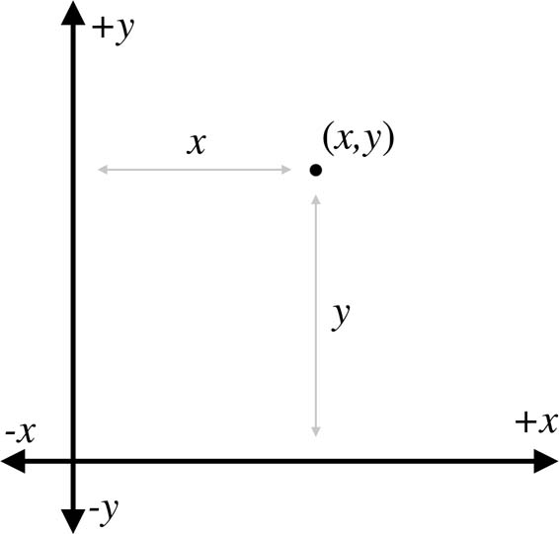

Slide 24
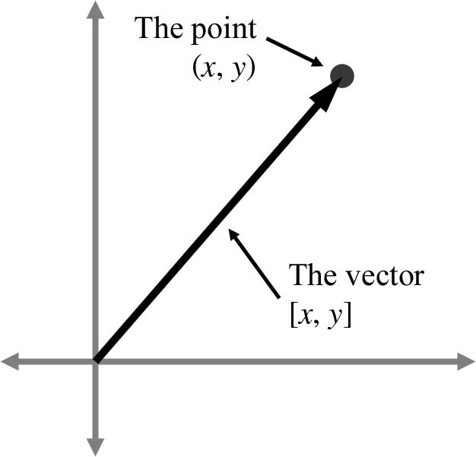

Slide 25
Key Things to Remember
Vectors don’t have a location.
They can be dragged around the world whenever it’s convenient.
We will be doing that a lot.
It’s tempting to think of them with tail at the origin. We can but don’t have to. Be flexible.

Slide 26
Sections 2.5-2.12: Vector Operations

Slide 27
Next: Vector Operations
Negation
Multiplication by a scalar
Addition and Subtraction
Displacement
Magnitude
Normalization
Dot product
Cross product

Slide 28
René Descartes
Remember René Descartes from Chapter 1?
He’s famous for (among other things) unifying algebra and geometry.
His observation that algebra and geometry are the same thing is particularly significant for us, because algebra is what we program, and geometry is what we see on the screen.

Slide 29

René Descartes
Our approach to vector operations would have pleased him.
We will describe both the algebra and the geometry behind vector operations.
Let’s get started…

Slide 30
Section 2.5: Negating a Vector

Slide 31
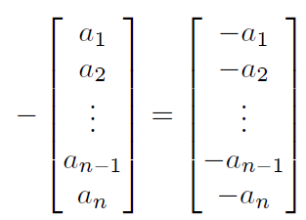
Vector Negation: Algebra
Negation is the additive inverse:
v + -v = -v + v = 0
To negate a vector, negate all of its components.

Slide 32
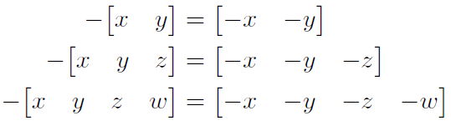
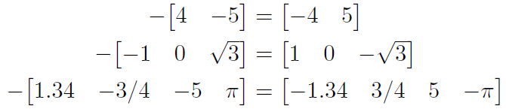
Examples

Slide 33
Vector Negation: Geometry
To negate a vector, make it point in the opposite direction.
Swap the head with the tail, that is.
A vector and its negative are parallel and have the same magnitude, but point in opposite directions.

Slide 34
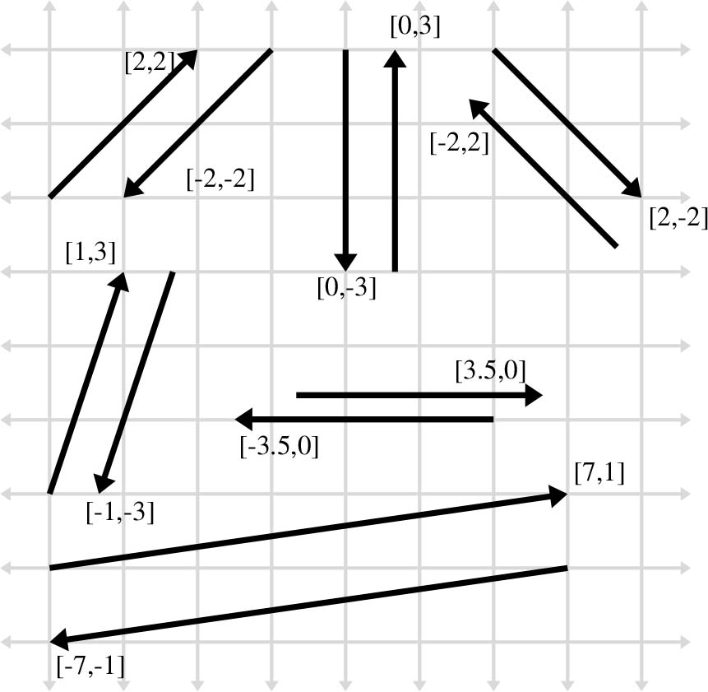

Slide 35
Section 2.6: Vector Multiplication by a Scalar

Slide 36
Vector Mult. by a Scalar: Algebra
Can multiply a vector by a scalar.
Result is a vector of the same dimension.
To multiply a vector by a scalar, multiply each component by the scalar.
For example, if ka = b, then b₁=ka₁, etc.
So vector negation is the same as multiplying by the scalar –1.
Division by a scalar same as multiplication by the scalar multiplicative inverse.

Slide 37
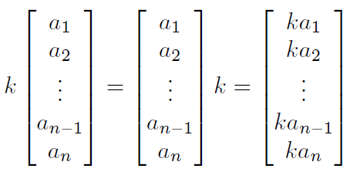

Slide 38
Vector Mult. by a Scalar: Geometry
Multiplication of a vector v by a scalar k stretches v by a factor of k
In the same direction if k is positive.
In the opposite direction if k is negative.
To see this, think about the Pythagorean Theorem.

Slide 39
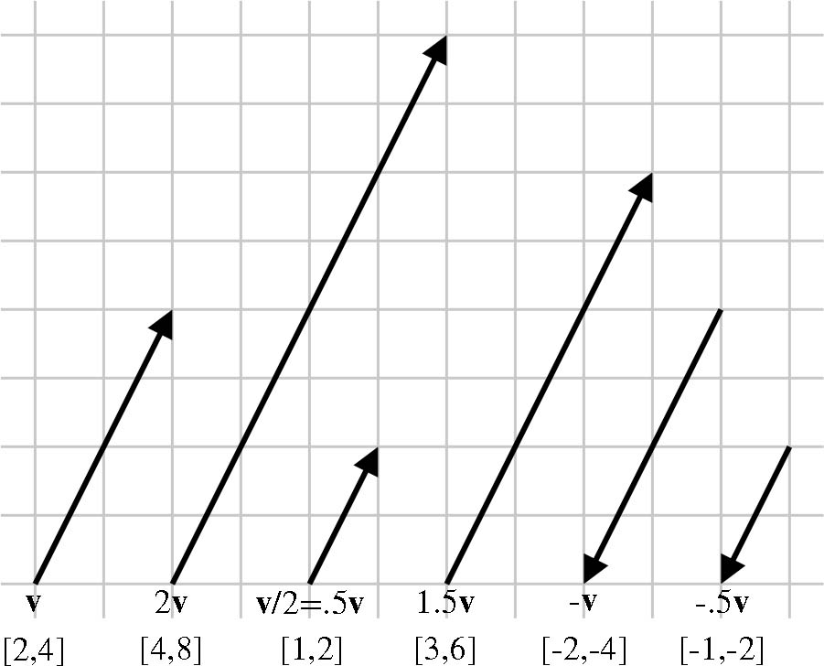

Slide 40
Section 2.7: Vector Addition and Subtraction

Slide 41
Vector Addition: Algebra
Can add two vectors of the same dimension.
Result is a vector of the same dimension.
To add two vectors, add their components.
For example, if a + b = c, then c₁ = a₁ + b₁, etc.
Subtract vectors by adding the negative of the second vector, so a – b = a + (– b)

Slide 42
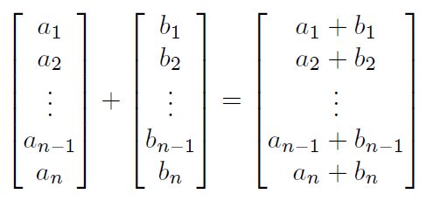
Vector Addition: Algebra

Slide 43
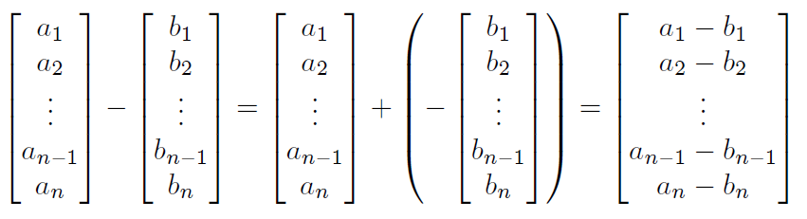
Vector Subtraction: Algebra

Slide 44
Algebraic Identities
Vector addition is associative.
a + (b + c) = (a + b) + c
Vector addition is commutative.
a + b = b + a
Vector subtraction is anti-commutative.
a – b = –(b – a)

Slide 45
Vector Addition: Geometry
To add vectors a and b: use the triangle rule.
Place the tail of a on the head of b.
a + b is the vector from the tail of b to the head of a.
Or the other way around: we can swap the roles of a and b (because vector addition is commutative, remember the algebra.)

Slide 46
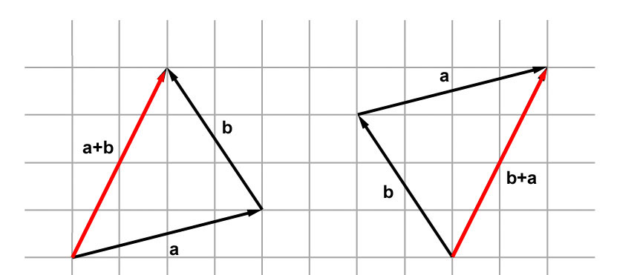
Triangle Rule for Addition
Algebra: [4, 1] + [-2, 3] = [2, 4]
Geometry:

Slide 47
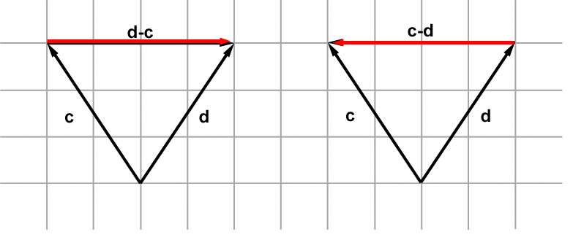
Triangle Rule for Subtraction
Place c and d tail to tail.
c – d is the vector from the head of d to the head of c (head-positive, tail-negative).

Slide 48
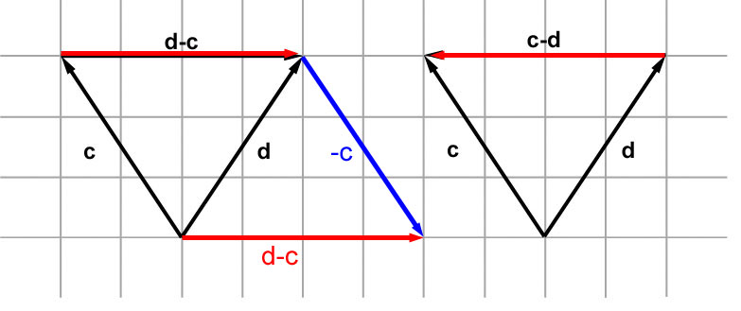

Slide 49
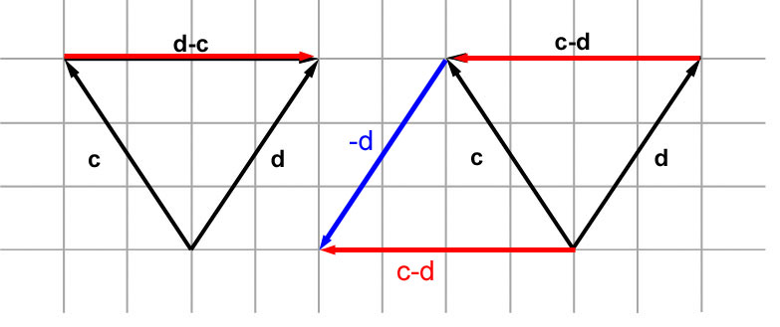

Slide 50
Adding Many Vectors
Repeat the triangle rule as many times as necessary?
Result: string all the vectors together. (Should we call this the polygon rule or the multitriangle rule?)

Slide 51
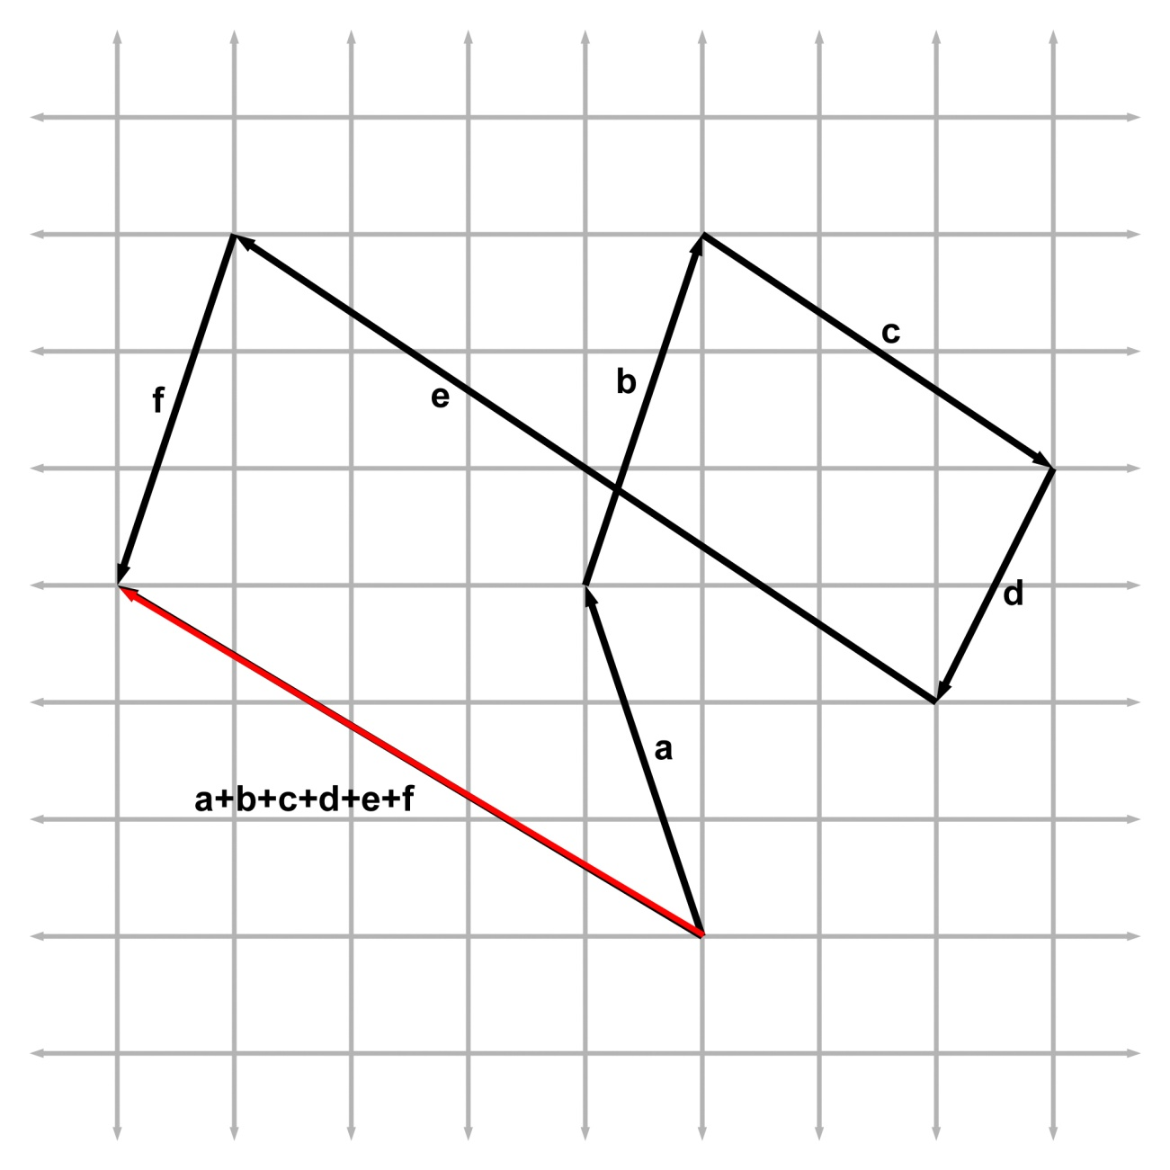

Slide 52
Vector Displacement: Algebra
Here’s how to get the vector displacement from point a to point b.
Let a and b be the vectors from the origin to the respective points.
The vector from a to b is b – a (the destination is positive)

Slide 53
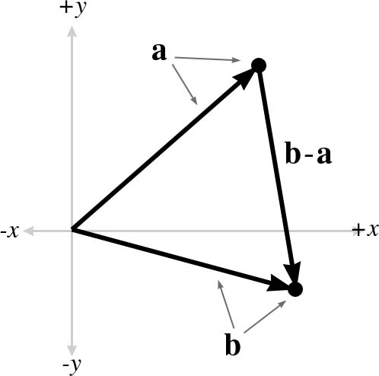
Vector Displacement: Geometry

Slide 54
Section 2.8: Vector Magnitude

Slide 55
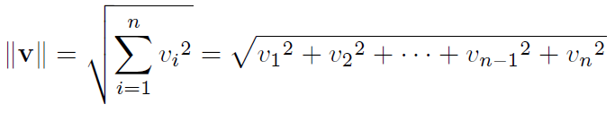
Vector Magnitude: Algebra
The magnitude of a vector is a scalar.
Also called the “norm”.
It is always positive

Slide 56
Vector Magnitude: Geometry
Magnitude of a vector is its length.
Use the Pythagorean theorem.
In the next slide, two vertical lines ||v|| means “magnitude of a vector v”, one vertical line |v_{x}| means “absolute value of a scalar v_{x}”

Slide 57
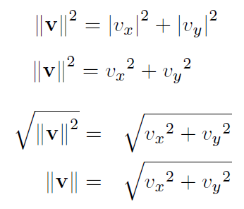
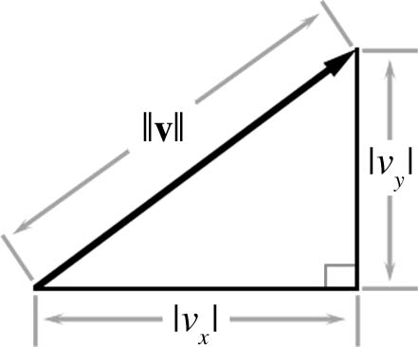

Slide 58
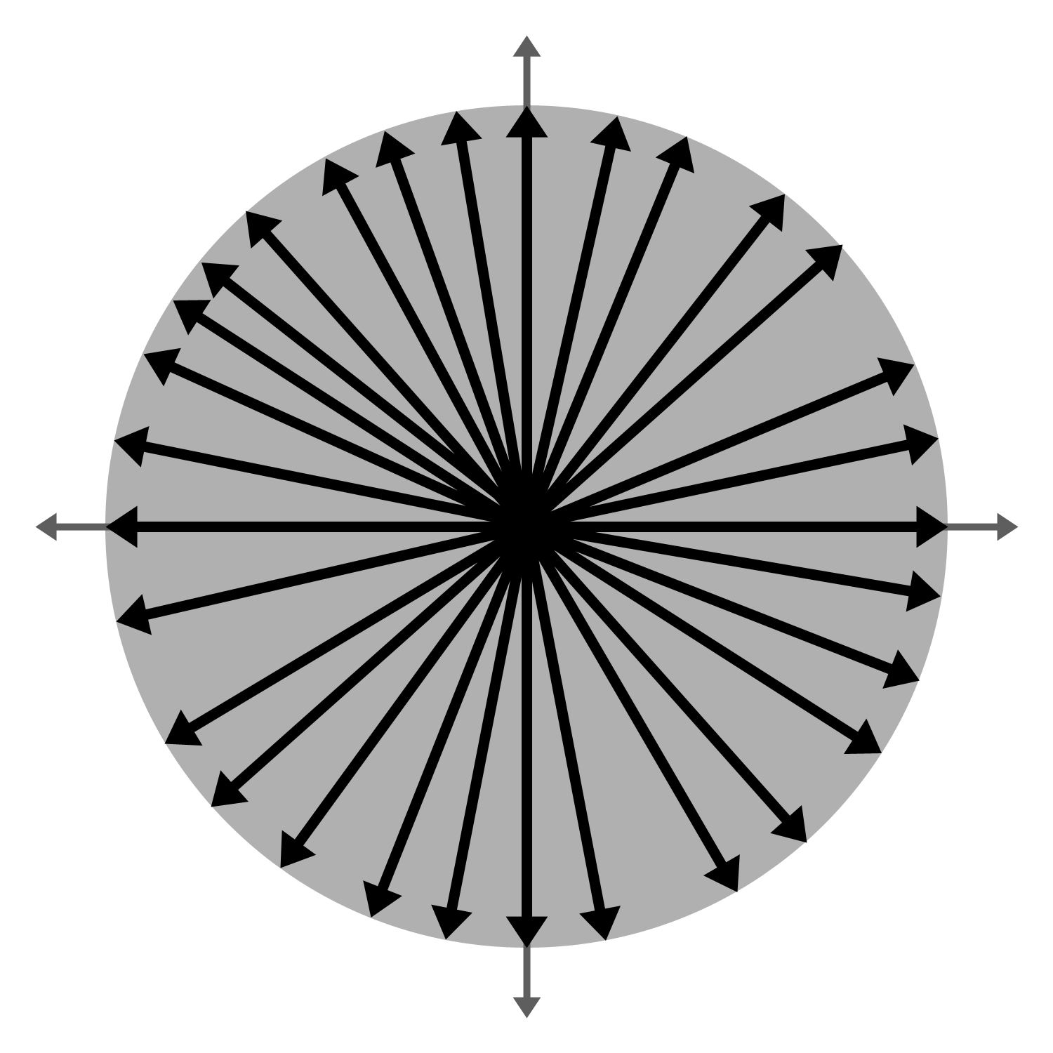
Observations
The zero vector has zero magnitude.
There are an infinite number of vectors of each magnitude (except zero).

Slide 59
Section 2.9: Unit Vectors

Slide 60

Normalization: Algebra
A normalized vector always has unit length.
To normalize a nonzero vector, divide by its magnitude.

Slide 61
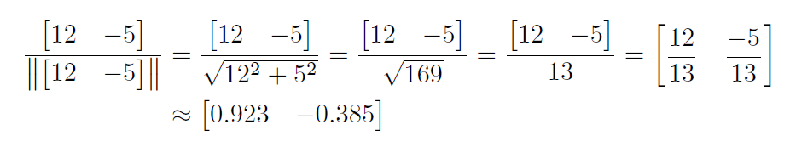
Example
Normalize [12, -5]:

Slide 62
Normalization: Geometry

Slide 63
Section 2.10: The Distance Formula

Slide 64
Application: Computing Distance
To find the geometric distance between two points a and b.
Compute the vector d from a to b.
Compute the magnitude of d.
We know how to do both of those things.

Slide 65
Section 2.11: Vector Dot Product

Slide 66

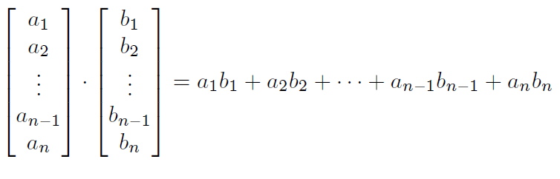
Dot Product: Algebra
Can take the dot product of two vectors of the same dimension. The result is a scalar.

Slide 67
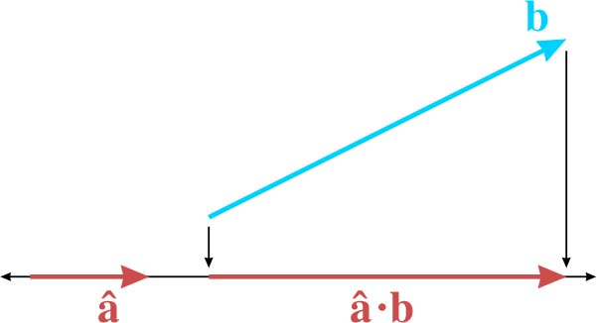
Dot Product: Geometry
Dot product is the magnitude of the projection of one vector onto another.

Slide 68
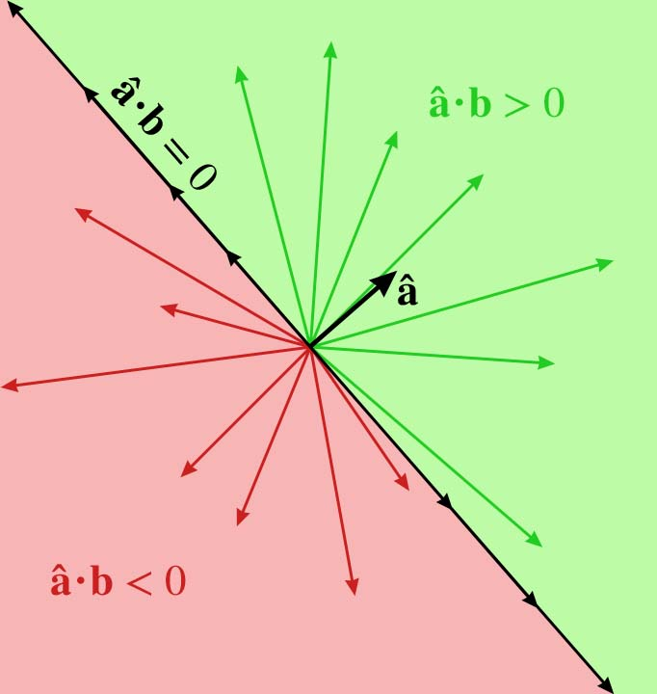
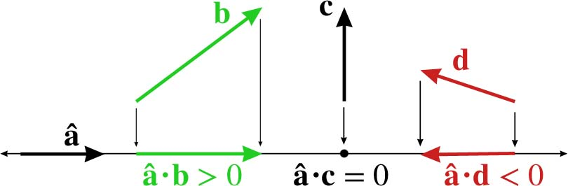
Sign of Dot Product

Slide 69
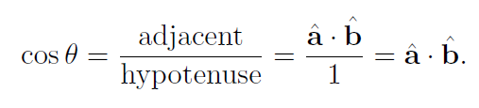

Dot Product: Geometry
Dot product can be used to find the angle between two vectors a and b.
First normalize a and b.
The angle between them is acos $\hat{a}$.$\hat{b}$

Slide 70
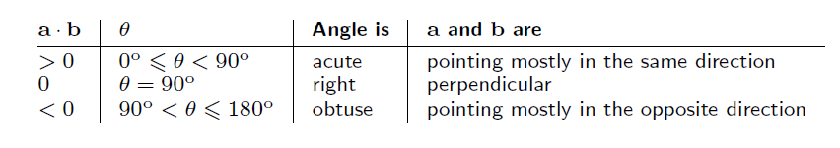
Sign of Dot Product

Slide 71
Section 2.12: Vector Cross Product

Slide 72
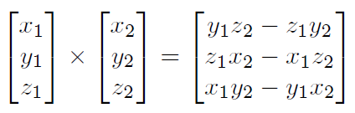
Cross Product: Algebra
Can take the cross product of two vectors of the same dimension.
Result is a vector of the same dimension.

Slide 73
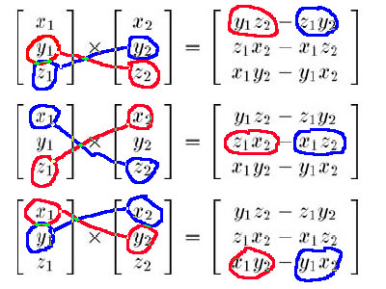
Cross Pattern

Slide 74
Cross Product: Geometry
Given 2 nonzero vectors a, b.
They are (must be) coplanar.
The cross product of a and b is a vector perpendicular to the plane of a and b.
The magnitude is related to the magnitude of a and b and the angle between a and b.
The magnitude is equal to the area of a parallelogram with sides a and b.

Slide 75

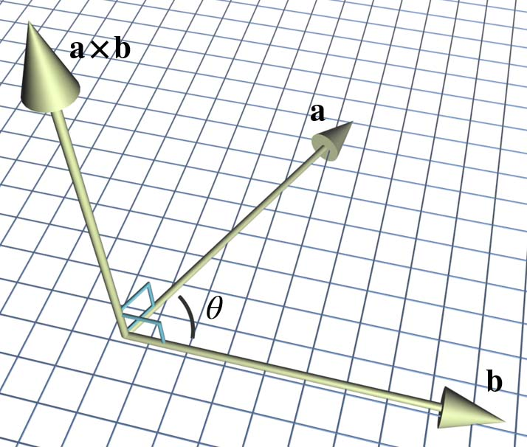

Slide 76
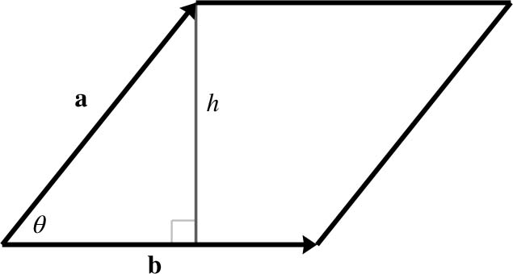
Area of this parallellogram is ||b|| h

Slide 77
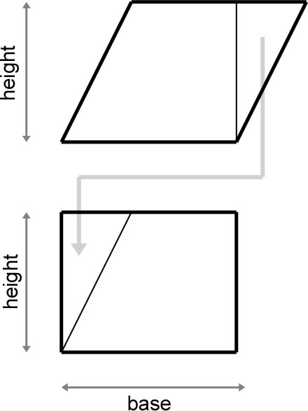
Aside: Here’s Why

Slide 78
Catch Your Breath
Are you OK with the fact that the area of a parallelogram is its base times its height measured perpendicularly to the base?
Now we’ll show that the area is

Slide 79
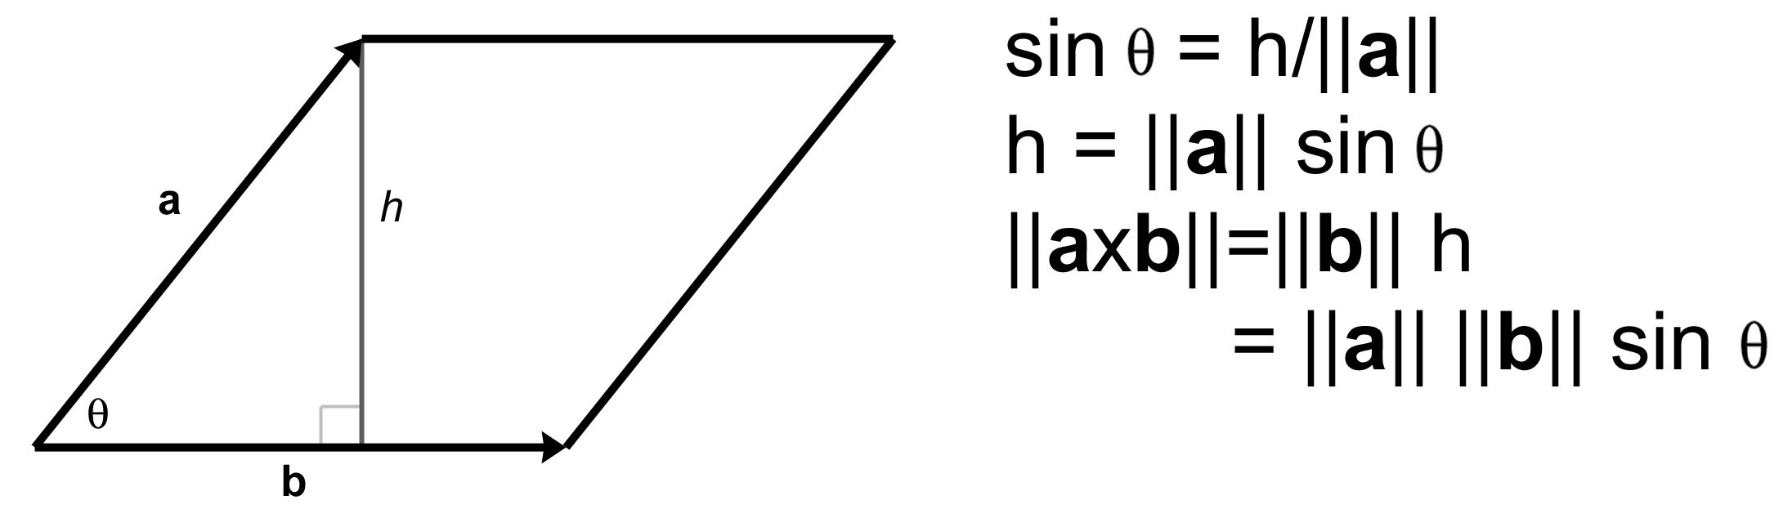

Slide 80
What About the Orientation?
That’s taken care of the magnitude. Now for the direction.
Does the vector a x b point up or down from the plane of a and b?
Place the tail of b at the head of a.
Look at whether the angle from a to b is clockwise or counterclockwise.
The result depends on whether coordinate system is left- or right-handed.

Slide 81
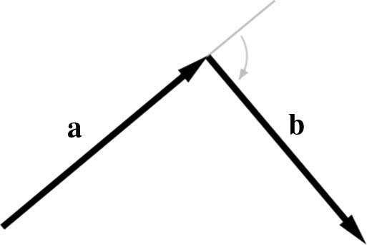

Slide 82
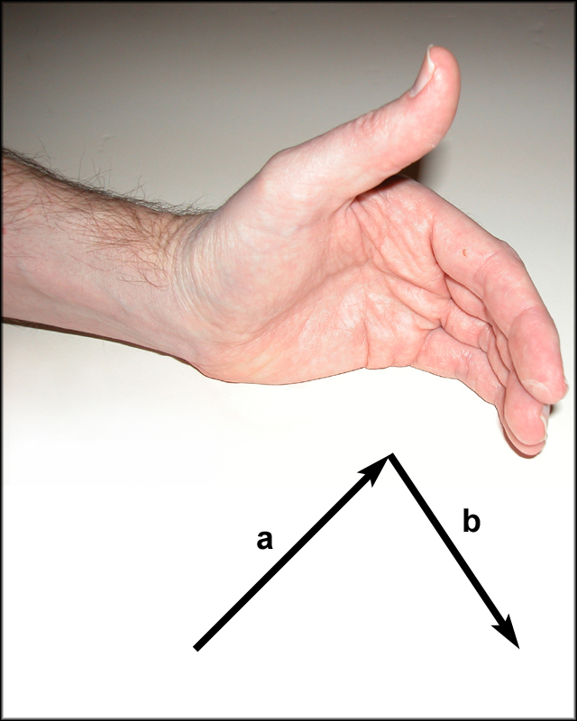
In a left-handed coordinate system, use your left hand.
Curl fingers in direction of vectors
Thumb points in direction of a x b

Slide 83
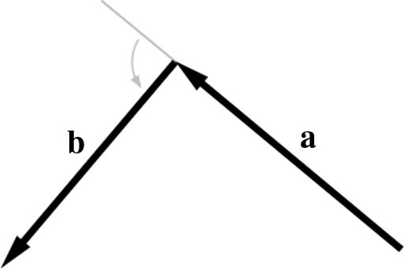

Slide 84
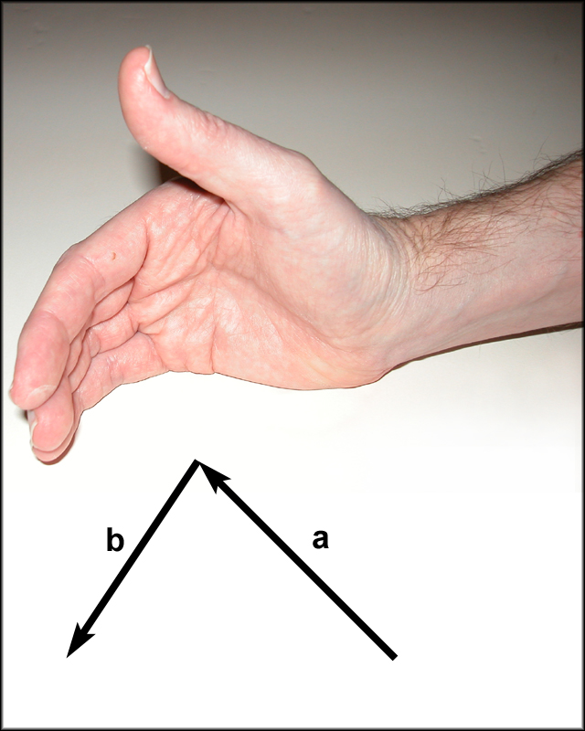
In a right-handed coordinate system, use your right hand
Curl fingers in direction of vectors
Thumb points in direction of a x b

Slide 85
Corollary
In a left-handed coordinate system, list your triangles in clockwise order.
Then you can compute a surface normal (a unit vector pointing out from the face of the triangle) by taking the cross product of two consecutive edges.

Slide 86
Computing a Surface Normal
Given a triangle with points a, b, c.
Compute the vector displacement from a to b, and the vector from b to c.
Take their cross product.
Normalize the resulting surface normal.
WARNING: some modeling programs may output zero-width triangles: these have a zero cross product. Don’t normalize it.

Slide 87
Facts About Dot and Cross Product
If a.b = 0, then a is perpendicular to b.
If a x b = 0, then a is parallel to b.
Dot product interprets every vector as being perpendicular to 0.
Cross product interprets every vector as being parallel to 0.
Neither is really the case, but both are a convenient fiction.

Slide 88
Section 2.13: Linear Algebra Identities

Slide 89


Slide 90
That concludes Chapter 2. Next, Chapter 3: Multiple Coordinate Spaces

